Slide 1
SEQUENTIAL CIRCUIT
GATED LATCH

Slide 2
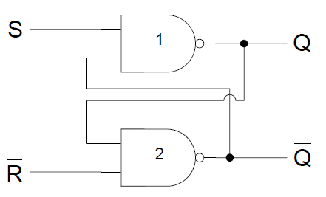
SR L ATCH

Slide 3
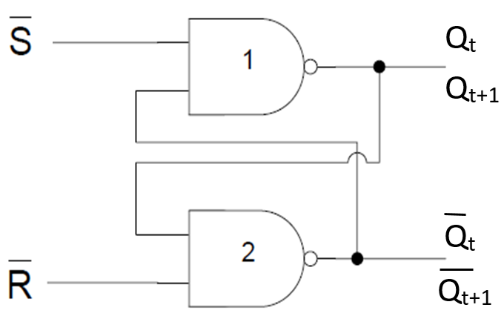
SR L ATCH

Slide 4
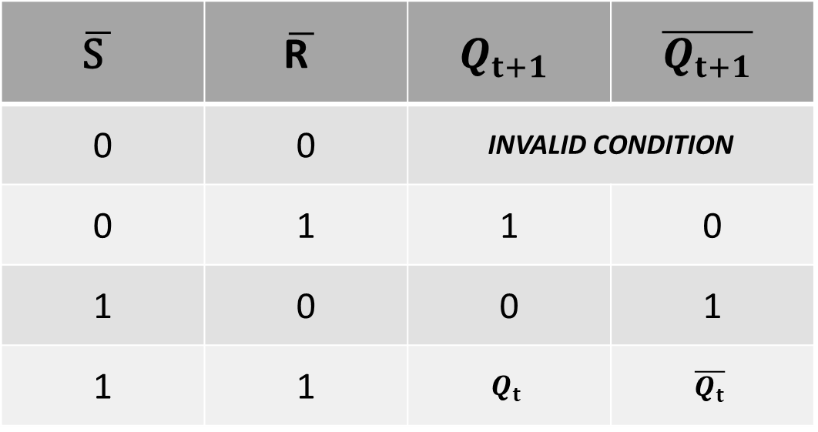
SR LATCH TABLE
$$\overline{\text{S} }$$ | $$\overline{\text{R} }$$ | $$Q_{t+1}$$ | $$\overline{Q_{t+1}}$$
0 | 0 | INVALID CONDITION
0 | 1 | 1 | 0
1 | 0 | 0 | 1
1 | 1 | $$Q_{t}$$ | $$\overline{Q_{t}}$$

Slide 5
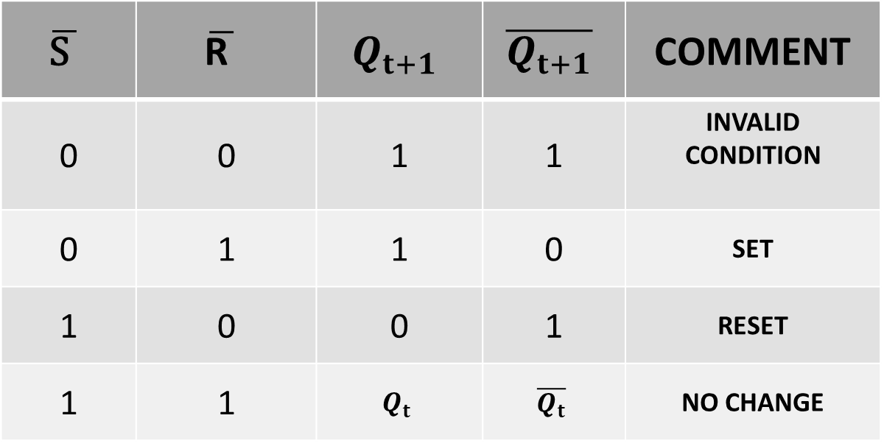
SR LATCH TABLE
$$\overline{\text{S} }$$ | $$\overline{\text{R} }$$ | $$Q_{t+1}$$ | $$\overline{Q_{t+1}}$$ | COMMENT
0 | 0 | 1 | 1 | INVALID CONDITION
0 | 1 | 1 | 0 | SET
1 | 0 | 0 | 1 | RESET
1 | 1 | $$Q_{t}$$ | $$\overline{Q_{t}}$$ | NO CHANGE

Slide 6
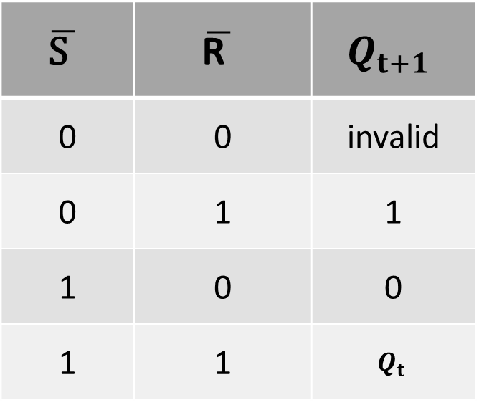
SR LATCH TABLE
$$\overline{\text{S} }$$ | $$\overline{\text{R} }$$ | $$Q_{t+1}$$
0 | 0 | invalid
0 | 1 | 1
1 | 0 | 0
1 | 1 | $$Q_{t}$$

Slide 7
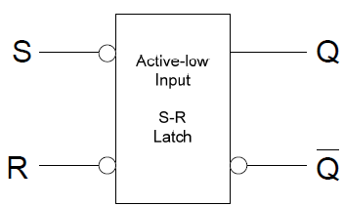
LOGIC SYMBOL

Slide 8
GATED SR LATCH
Gated SR latch requires an enable input.

Slide 9
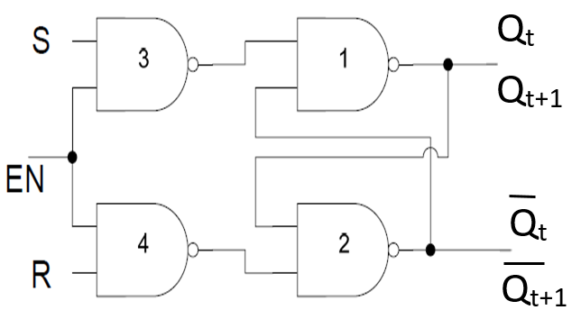
GATED SR LATCH

Slide 10
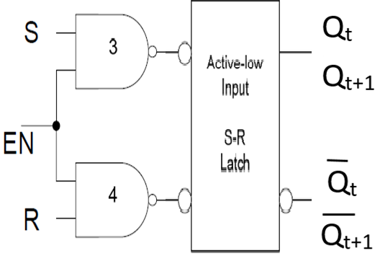
GATED SR LATCH

Slide 11
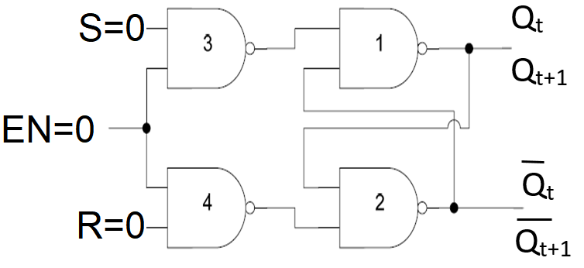
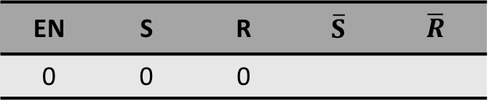
GATED SR LATCH
EN | S | R | $$\overline{S}$$ | $$\overline{R}$$
0 | 0 | 0

Slide 12

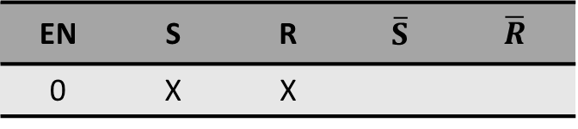
GATED SR LATCH
EN | S | R | $$\overline{S}$$ | $$\overline{R}$$
0 | X | X

Slide 13
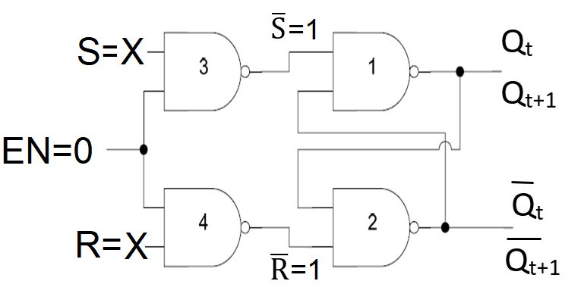
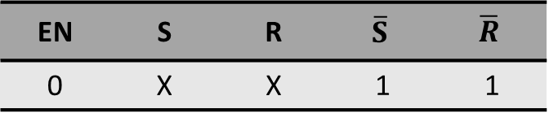
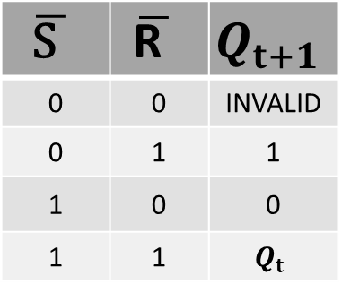
GATED SR LATCH
EN | S | R | $$\overline{S}$$ | $$\overline{R}$$
0 | X | X | 1 | 1
$$\overline{\text{S} }$$ | $$\overline{\text{R} }$$ | $$Q_{t+1}$$
0 | 0 | INVALID
0 | 1 | 1
1 | 0 | 0
1 | 1 | $$Q_{t}$$

Slide 14
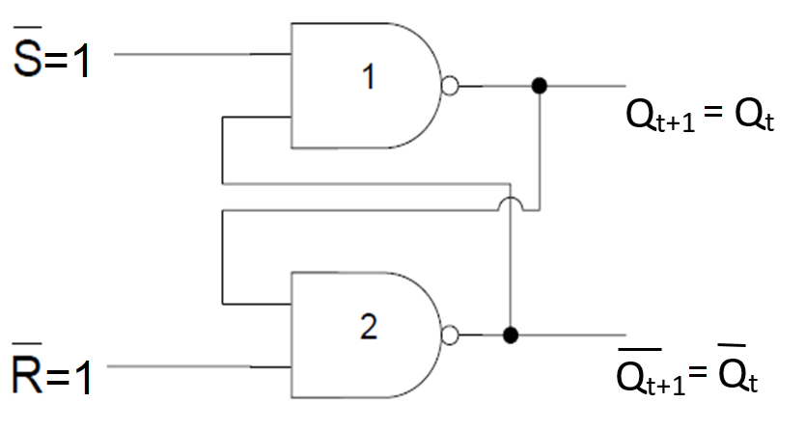
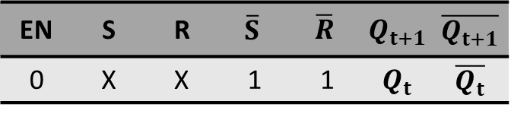
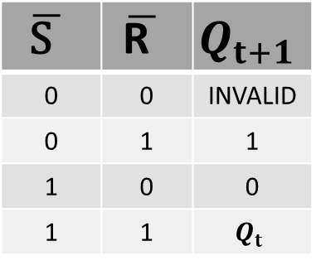
GATED SR LATCH
EN | S | R | $$\overline{S}$$ | $$\overline{R}$$ | $$Q_{t+1}$$ | $$\overline{Q_{t+1}}$$
0 | X | X | 1 | 1 | $$Q_{t}$$ | $$\overline{Q_{t}}$$
$$\overline{\text{S} }$$ | $$\overline{\text{R} }$$ | $$Q_{t+1}$$
0 | 0 | INVALID
0 | 1 | 1
1 | 0 | 0
1 | 1 | $$Q_{t}$$

Slide 15
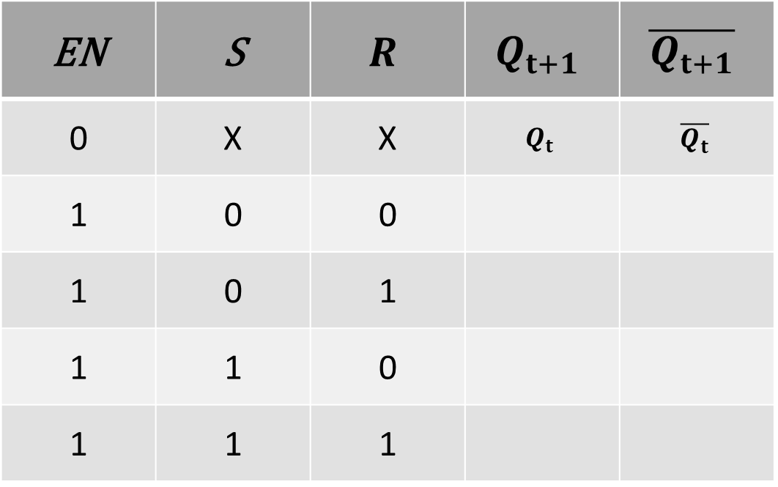
GATED SR LATCH TABLE
EN | S | $$R$$ | $$Q_{t+1}$$ | $$\overline{Q_{t+1}}$$
0 | X | X | $$Q_{t}$$ | $$\overline{Q_{t}}$$
1 | 0 | 0
1 | 0 | 1
1 | 1 | 0
1 | 1 | 1

Slide 16
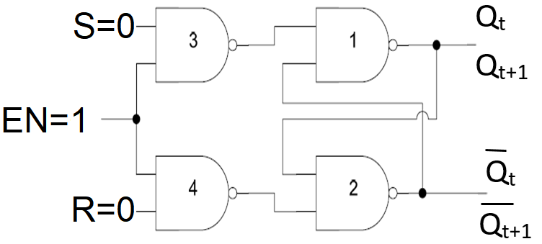
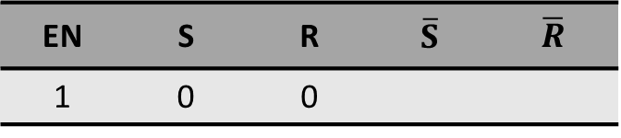
GATED SR LATCH
EN | S | R | $$\overline{S}$$ | $$\overline{R}$$
1 | 0 | 0

Slide 17
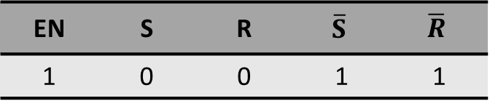
GATED SR LATCH
EN | S | R | $$\overline{S}$$ | $$\overline{R}$$
1 | 0 | 0 | 1 | 1

Slide 18
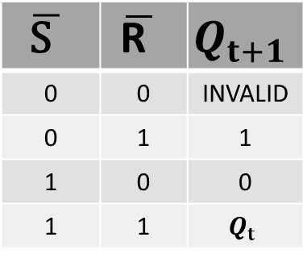
GATED SR LATCH
EN | S | R | $$\overline{S}$$ | $$\overline{R}$$
1 | 0 | 0 | 1 | 1
$$\overline{\text{S} }$$ | $$\overline{\text{R} }$$ | $$Q_{t+1}$$
0 | 0 | INVALID
0 | 1 | 1
1 | 0 | 0
1 | 1 | $$Q_{t}$$

Slide 19
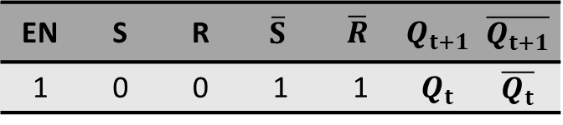

GATED SR LATCH
EN | S | R | $$\overline{S}$$ | $$\overline{R}$$ | $$Q_{t+1}$$ | $$\overline{Q_{t+1}}$$
1 | 0 | 0 | 1 | 1 | $$Q_{t}$$ | $$\overline{Q_{t}}$$
$$\overline{\text{S} }$$ | $$\overline{\text{R} }$$ | $$Q_{t+1}$$
0 | 0 | INVALID
0 | 1 | 1
1 | 0 | 0
1 | 1 | $$Q_{t}$$

Slide 20
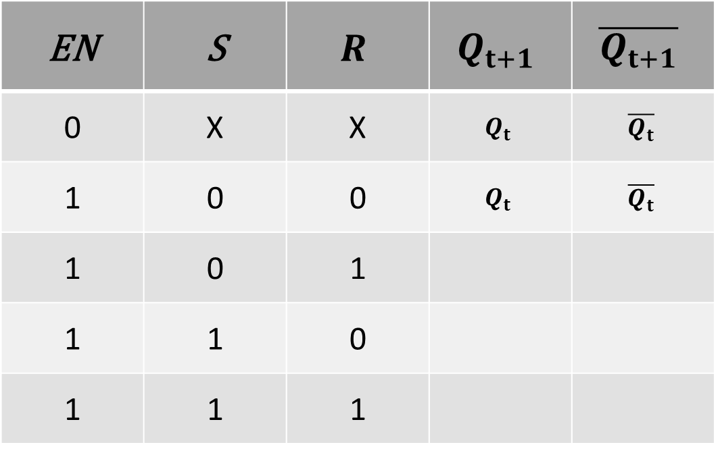
GATED SR LATCH TABLE
EN | S | $$R$$ | $$Q_{t+1}$$ | $$\overline{Q_{t+1}}$$
0 | X | X | $$Q_{t}$$ | $$\overline{Q_{t}}$$
1 | 0 | 0 | $$Q_{t}$$ | $$\overline{Q_{t}}$$
1 | 0 | 1
1 | 1 | 0
1 | 1 | 1

Slide 21
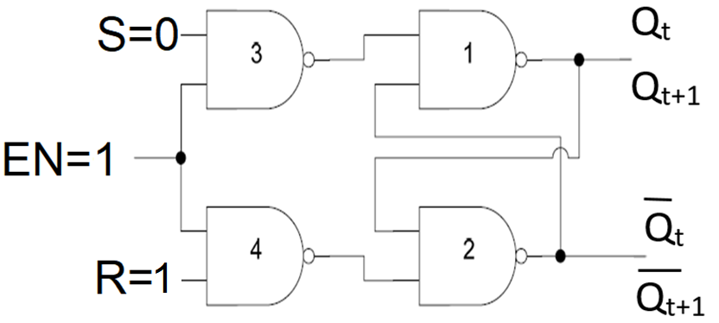
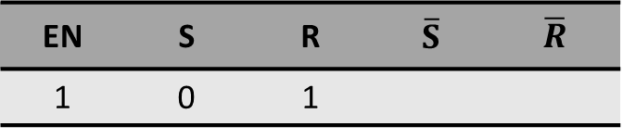
GATED SR LATCH
EN | S | R | $$\overline{S}$$ | $$\overline{R}$$
1 | 0 | 1

Slide 22
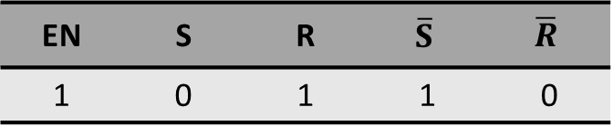
GATED SR LATCH
EN | S | R | $$\overline{S}$$ | $$\overline{R}$$
1 | 0 | 1 | 1 | 0

Slide 23
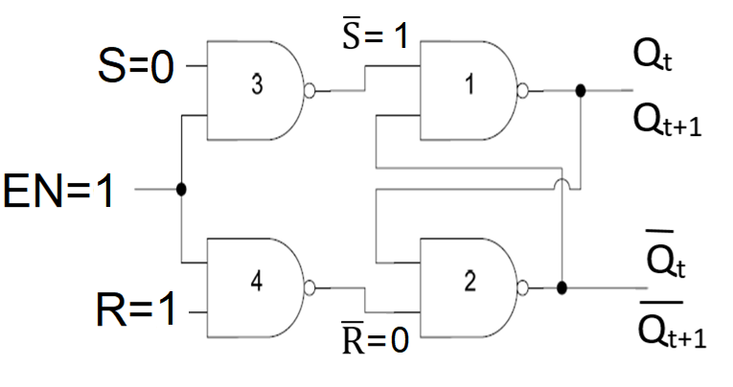

GATED SR LATCH
EN | S | R | $$\overline{S}$$ | $$\overline{R}$$
1 | 0 | 1 | 1 | 0
$$\overline{\text{S} }$$ | $$\overline{\text{R} }$$ | $$Q_{t+1}$$
0 | 0 | INVALID
0 | 1 | 1
1 | 0 | 0
1 | 1 | $$Q_{t}$$

Slide 24
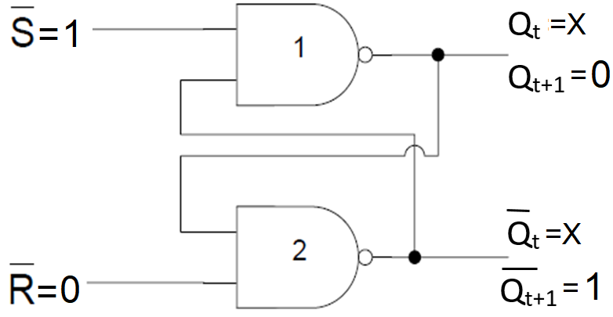
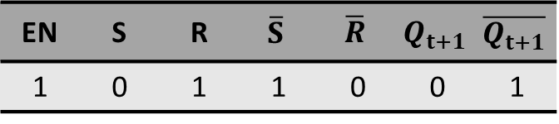
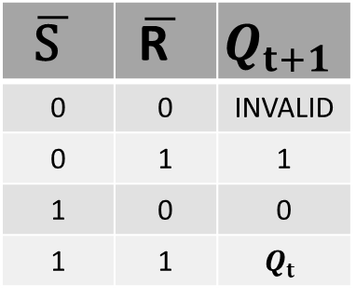
GATED SR LATCH
EN | S | R | $$\overline{S}$$ | $$\overline{R}$$ | $$Q_{t+1}$$ | $$\overline{Q_{t+1}}$$
1 | 0 | 1 | 1 | 0 | 0 | 1
$$\overline{\text{S} }$$ | $$\overline{\text{R} }$$ | $$Q_{t+1}$$
0 | 0 | INVALID
0 | 1 | 1
1 | 0 | 0
1 | 1 | $$Q_{t}$$

Slide 25
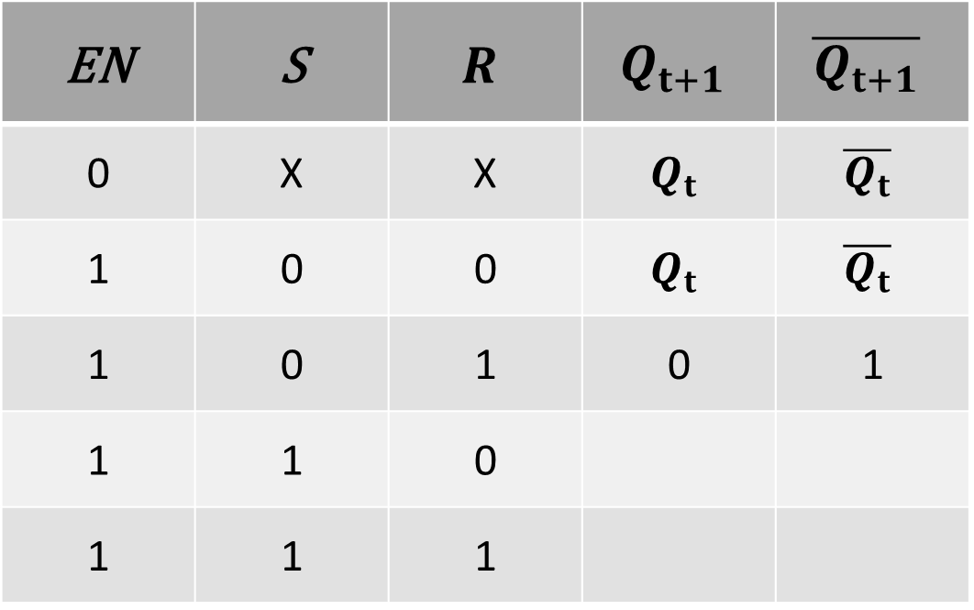
GATED SR LATCH TABLE
EN | S | $$R$$ | $$Q_{t+1}$$ | $$\overline{Q_{t+1}}$$
0 | X | X | $$Q_{t}$$ | $$\overline{Q_{t}}$$
1 | 0 | 0 | $$Q_{t}$$ | $$\overline{Q_{t}}$$
1 | 0 | 1 | 0 | 1
1 | 1 | 0
1 | 1 | 1

Slide 26
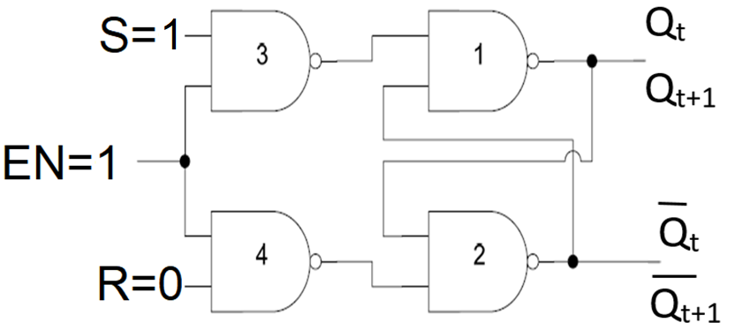
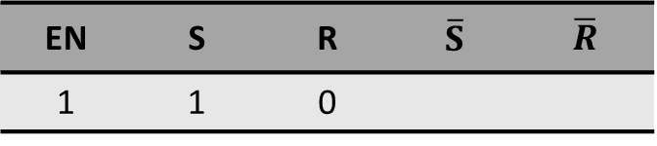
GATED SR LATCH
EN | S | R | $$\overline{S}$$ | $$\overline{R}$$
1 | 1 | 0

Slide 27
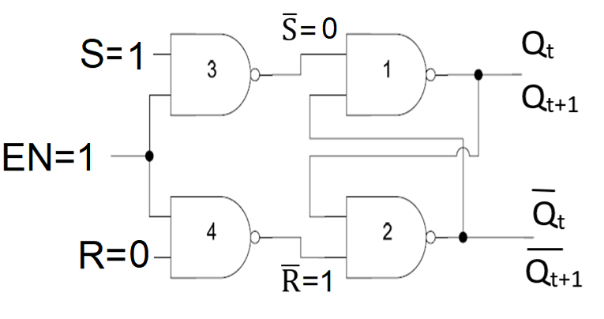
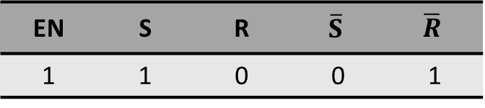

GATED SR LATCH
EN | S | R | $$\overline{S}$$ | $$\overline{R}$$
1 | 1 | 0 | 0 | 1
$$\overline{\text{S} }$$ | $$\overline{\text{R} }$$ | $$Q_{t+1}$$
0 | 0 | INVALID
0 | 1 | 1
1 | 0 | 0
1 | 1 | $$Q_{t}$$

Slide 28

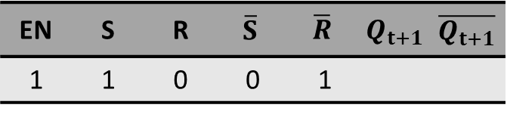
GATED SR LATCH
EN | S | R | $$\overline{S}$$ | $$\overline{R}$$ | $$Q_{t+1}$$ | $$\overline{Q_{t+1}}$$
1 | 1 | 0 | 0 | 1
$$\overline{\text{S} }$$ | $$\overline{\text{R} }$$ | $$Q_{t+1}$$
0 | 0 | INVALID
0 | 1 | 1
1 | 0 | 0
1 | 1 | $$Q_{t}$$

Slide 29
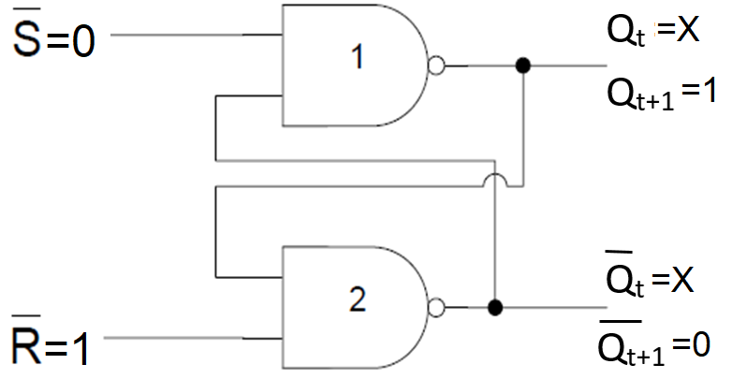
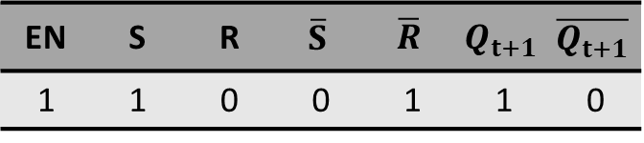

GATED SR LATCH
EN | S | R | $$\overline{S}$$ | $$\overline{R}$$ | $$Q_{t+1}$$ | $$\overline{Q_{t+1}}$$
1 | 1 | 0 | 0 | 1 | 1 | 0
$$\overline{\text{S} }$$ | $$\overline{\text{R} }$$ | $$Q_{t+1}$$
0 | 0 | INVALID
0 | 1 | 1
1 | 0 | 0
1 | 1 | $$Q_{t}$$

Slide 30
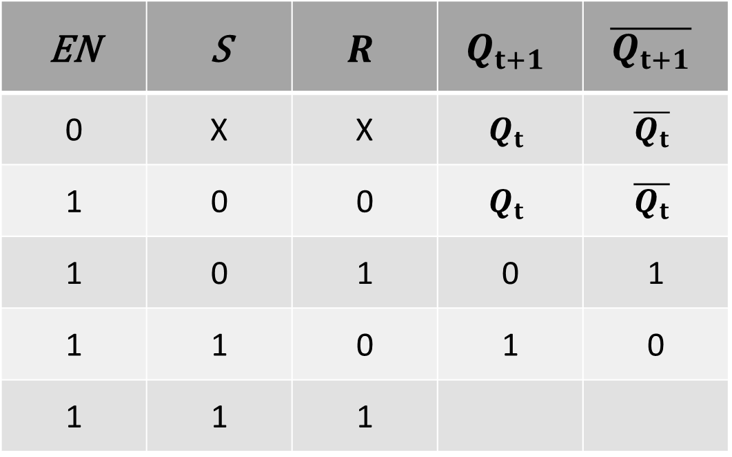
GATED SR LATCH TABLE
EN | S | $$R$$ | $$Q_{t+1}$$ | $$\overline{Q_{t+1}}$$
0 | X | X | $$Q_{t}$$ | $$\overline{Q_{t}}$$
1 | 0 | 0 | $$Q_{t}$$ | $$\overline{Q_{t}}$$
1 | 0 | 1 | 0 | 1
1 | 1 | 0 | 1 | 0
1 | 1 | 1

Slide 31
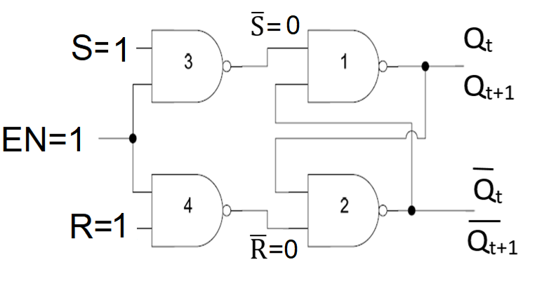
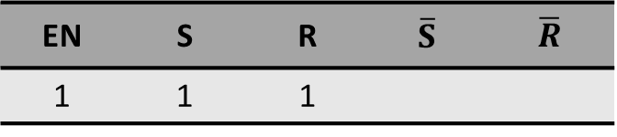
GATED SR LATCH
EN | S | R | $$\overline{S}$$ | $$\overline{R}$$
1 | 1 | 1

Slide 32

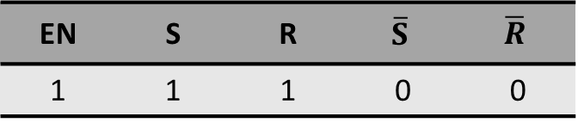

GATED SR LATCH
EN | S | R | $$\overline{S}$$ | $$\overline{R}$$
1 | 1 | 1 | 0 | 0
$$\overline{\text{S} }$$ | $$\overline{\text{R} }$$ | $$Q_{t+1}$$
0 | 0 | INVALID
0 | 1 | 1
1 | 0 | 0
1 | 1 | $$Q_{t}$$

Slide 33
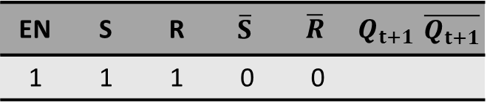
GATED SR LATCH
EN | S | R | $$\overline{S}$$ | $$\overline{R}$$ | $$Q_{t+1}$$ | $$\overline{Q_{t+1}}$$
1 | 1 | 1 | 0 | 0
$$\overline{\text{S} }$$ | $$\overline{\text{R} }$$ | $$Q_{t+1}$$
0 | 0 | INVALID
0 | 1 | 1
1 | 0 | 0
1 | 1 | $$Q_{t}$$

Slide 34
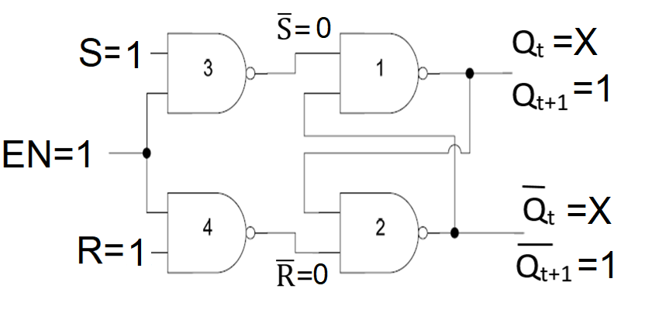
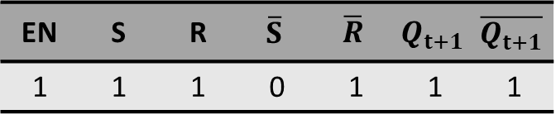

GATED SR LATCH
EN | S | R | $$\overline{S}$$ | $$\overline{R}$$ | $$Q_{t+1}$$ | $$\overline{Q_{t+1}}$$
1 | 1 | 1 | 0 | 1 | 1 | 1
$$\overline{\text{S} }$$ | $$\overline{\text{R} }$$ | $$Q_{t+1}$$
0 | 0 | INVALID
0 | 1 | 1
1 | 0 | 0
1 | 1 | $$Q_{t}$$

Slide 35
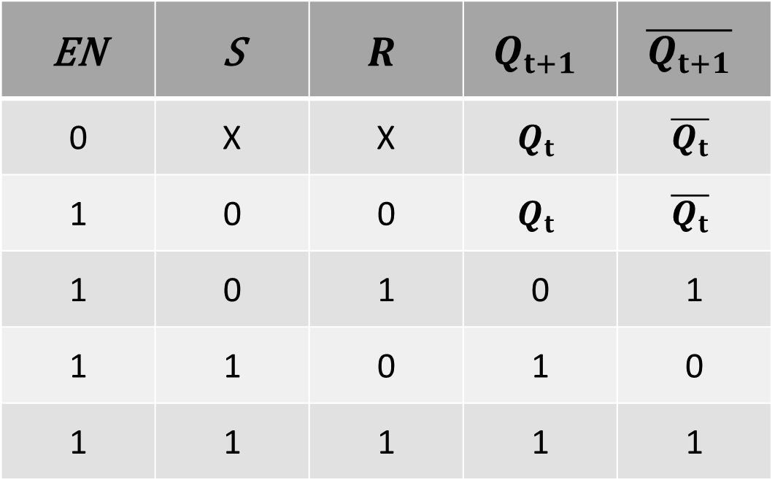
GATED SR LATCH TABLE
EN | S | $$R$$ | $$Q_{t+1}$$ | $$\overline{Q_{t+1}}$$
0 | X | X | $$Q_{t}$$ | $$\overline{Q_{t}}$$
1 | 0 | 0 | $$Q_{t}$$ | $$\overline{Q_{t}}$$
1 | 0 | 1 | 0 | 1
1 | 1 | 0 | 1 | 0
1 | 1 | 1 | 1 | 1

Slide 36
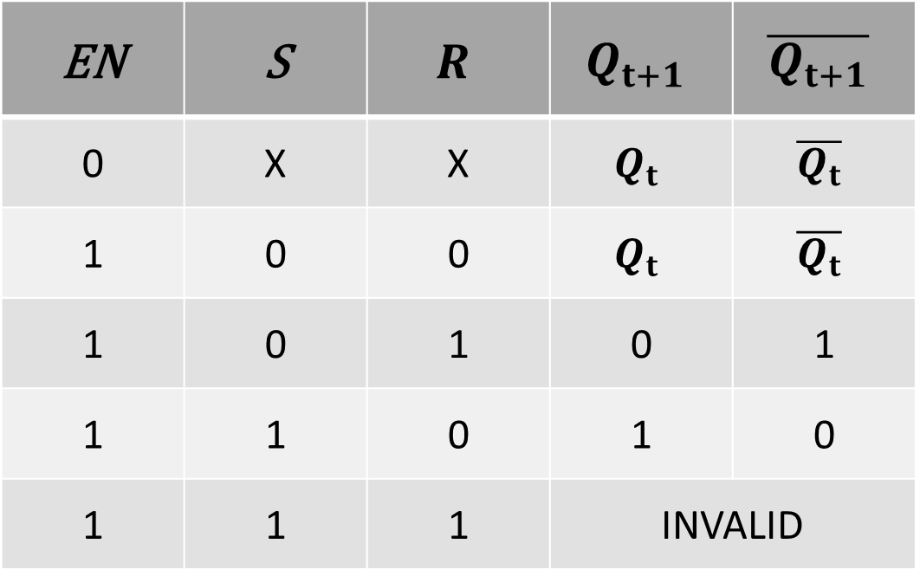
GATED SR LATCH TABLE
EN | S | $$R$$ | $$Q_{t+1}$$ | $$\overline{Q_{t+1}}$$
0 | X | X | $$Q_{t}$$ | $$\overline{Q_{t}}$$
1 | 0 | 0 | $$Q_{t}$$ | $$\overline{Q_{t}}$$
1 | 0 | 1 | 0 | 1
1 | 1 | 0 | 1 | 0
1 | 1 | 1 | INVALID

Slide 37
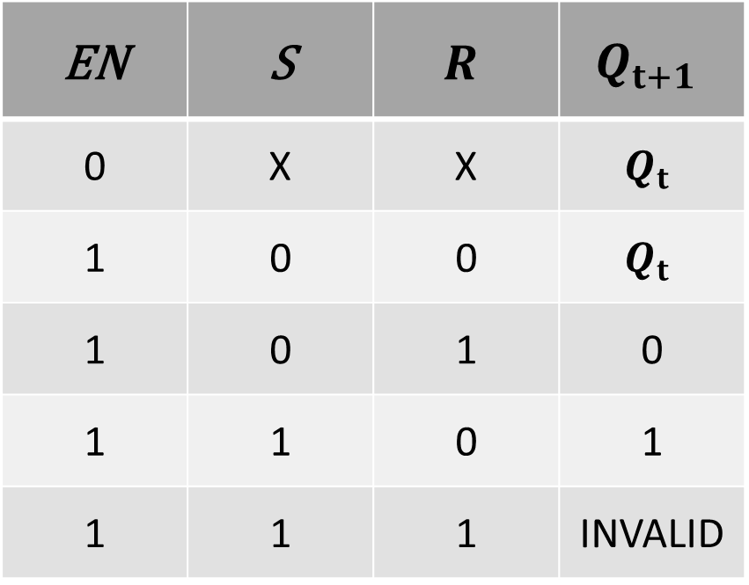
GATED SR LATCH TABLE SUMMARY
EN | S | $$R$$ | $$Q_{t+1}$$
0 | X | X | $$Q_{t}$$
1 | 0 | 0 | $$Q_{t}$$
1 | 0 | 1 | 0
1 | 1 | 0 | 1
1 | 1 | 1 | INVALID

Slide 38
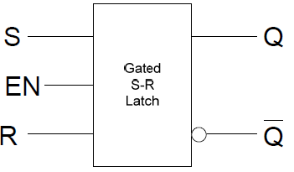
BLOCK DIAGRAM

Slide 39


TIMING DIAGRAMS
EN | S | $$R$$ | $$Q_{t+1}$$
0 | X | X | $$Q_{t}$$
1 | 0 | 0 | $$Q_{t}$$
1 | 0 | 1 | 0
1 | 1 | 0 | 1
1 | 1 | 1 | INVALID

Slide 40


TIMING DIAGRAMS
EN | S | $$R$$ | $$Q_{t+1}$$
0 | X | X | $$Q_{t}$$
1 | 0 | 0 | $$Q_{t}$$
1 | 0 | 1 | 0
1 | 1 | 0 | 1
1 | 1 | 1 | INVALID

Slide 41
GATED D LATCH
Gated D latch is called Transparent Latch.

Slide 42

GATED D LATCH

Slide 43

GATED D LATCH

Slide 44

GATED D LATCH
EN | D | S | R
0 | X | X | X

Slide 45



GATED D LATCH
EN | D | S | R | $$Q_{t+1}$$ | $$\overline{Q_{t+1}}$$
0 | X | 0 | 0 | $$Q_{t}$$ | $$\overline{Q_{t}}$$
EN | S | $$R$$ | $$Q_{t+1}$$
0 | X | X | $$Q_{t}$$
1 | 0 | 0 | $$Q_{t}$$
1 | 0 | 1 | 0
1 | 1 | 0 | 1
1 | 1 | 1 | INVALID

Slide 46

GATED D LATCH TABLE
EN | D | $$Q_{t+1}$$ | $$\overline{Q_{t+1}}$$
0 | X | $$Q_{t}$$ | $$\overline{Q_{t}}$$
1 | 0
1 | 1

Slide 47

GATED D LATCH
EN | D | S | R
1 | 0

Slide 48

GATED D LATCH
EN | D | S | R
1 | 0 | 0 | 1

Slide 49


GATED D LATCH
EN | D | S | R | $$Q_{t+1}$$ | $$\overline{Q_{t+1}}$$
0 | X | 0 | 0
EN | S | $$R$$ | $$Q_{t+1}$$
0 | X | X | $$Q_{t}$$
1 | 0 | 0 | $$Q_{t}$$
1 | 0 | 1 | 0
1 | 1 | 0 | 1
1 | 1 | 1 | INVALID

Slide 50



GATED D LATCH
EN | D | S | R | $$Q_{t+1}$$ | $$\overline{Q_{t+1}}$$
1 | 0 | 0 | 1 | 0 | 1
EN | S | $$R$$ | $$Q_{t+1}$$
0 | X | X | $$Q_{t}$$
1 | 0 | 0 | $$Q_{t}$$
1 | 0 | 1 | 0
1 | 1 | 0 | 1
1 | 1 | 1 | INVALID

Slide 51

GATED D LATCH TABLE
EN | D | $$Q_{t+1}$$ | $$\overline{Q_{t+1}}$$
0 | X | $$Q_{t}$$ | $$\overline{Q_{t}}$$
1 | 0 | 0 | 1
1 | 1

Slide 52

GATED D LATCH
EN | D | S | R
1 | 1

Slide 53

GATED D LATCH
EN | D | S | R
1 | 1 | 1 | 0

Slide 54

GATED D LATCH
EN | D | S | R | $$Q_{t+1}$$ | $$\overline{Q_{t+1}}$$
0 | X | 0 | 0
EN | S | $$R$$ | $$Q_{t+1}$$
0 | X | X | $$Q_{t}$$
1 | 0 | 0 | $$Q_{t}$$
1 | 0 | 1 | 0
1 | 1 | 0 | 1
1 | 1 | 1 | INVALID

Slide 55



GATED D LATCH
EN | D | S | R | $$Q_{t+1}$$ | $$\overline{Q_{t+1}}$$
1 | 1 | 1 | 0 | 1 | 0
EN | S | $$R$$ | $$Q_{t+1}$$
0 | X | X | $$Q_{t}$$
1 | 0 | 0 | $$Q_{t}$$
1 | 0 | 1 | 0
1 | 1 | 0 | 1
1 | 1 | 1 | INVALID

Slide 56

GATED D LATCH TABLE
EN | D | $$Q_{t+1}$$ | $$\overline{Q_{t+1}}$$
0 | X | $$Q_{t}$$ | $$\overline{Q_{t}}$$
1 | 0 | 0 | 1
1 | 1 | 1 | 0

Slide 57


GATED D LATCH TABLE

Slide 58

GATED D LATCH TABLE SUMMARY
EN | D | $$Q_{t+1}$$
0 | X | $$Q_{t}$$
1 | 0 | 0
1 | 1 | 1

Slide 59


TIMING DIAGRAM D LATCH
EN | D | $$Q_{t+1}$$
0 | X | $$Q_{t}$$
1 | 0 | 0
1 | 1 | 1

